Slide 1



Exploratory Data Analysis of Uber Dataset
Dive into the Uber dataset to uncover insights about ride patterns, hotspots, and more. This in-depth analysis will help us better understand the complexities of urban transportation.
by Ahad Rehman

Slide 2

Problem Statement
Uber has a constant imbalance in the demand and supply of rides which promotes poor customer retention. To achieve a balance and ensure there is a sufficient supply of rides to match the demand of customers, I will identify peak hours of the day in the most occurring start locations. This will help to know the locations to dispatch more riders to and what hours to do so. With this analysis we are looking to increase customer satisfaction and customer retention and once this is achieved, it’ll will ultimately boost profit and efficiency for Uber.

Slide 3
Overview of the Uber Dataset
Ride Details
Features
Dataset Source
The dataset includes information about individual Uber rides, such as pick-up and drop-off locations, distance, duration, and fare.
It has entries consisting of the start date and end date of the trip in a datetime format, Category of the trip, Start Location, End Location, Miles of each trip and the Purpose of each trip.
The dataset we would be using for this Exploratory Data Analysis is the Uber drives dataset gotten from Kaggle. This dataset comprises of a year long data of Uber trips in United State of America.

Slide 4
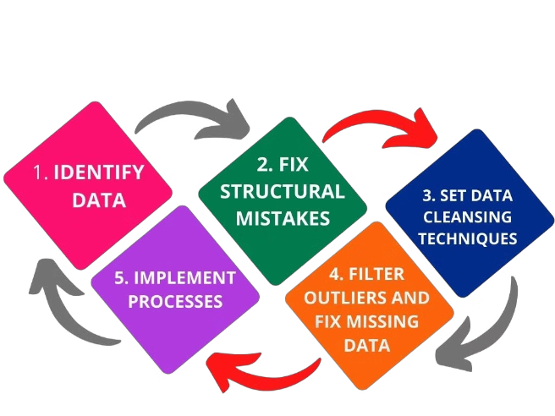
Data Cleaning and Preprocessing
1
Identify Outliers
Detect and remove erroneous data points that could skew the analysis, such as unrealistically long rides or invalid coordinates. renamed the column headers foe easy referencing.
2
Handle Missing Values
Address any gaps in the data by imputing or dropping incomplete records, ensuring a clean dataset for further exploration. The Start_date and End_start was split into Hour, Day, Day of the week, month and weekday.
3
Enrich with Metadata
Incorporate additional contextual data, like weather or event information, to provide a more holistic understanding of ride patterns.

Slide 5


Patterns and Trends
Ride Hotspots
Identify high-demand areas by mapping ride pickup and drop-off locations on a city grid:- The highest pick-up point location is Cary.
Temporal Variations
Analyze ride volume and duration across different times of day and days of the week:- The day of the week with most patronage is Friday, and the least is Saturday.
Purpose of Trips and the start/stop locations
Most trips are for business.
Most of the start & stop transit is between Cary and Morrisville.

Slide 6
Insights and Key Takeaways
Peak Hour Trends
Suburban Demand
Seasonal Variations
Uber rides peak during morning and evening rush hours, highlighting the service's role in commuting.
Suburban areas show significant Uber usage, suggesting the service provides an important transportation option for non-urban residents.
Ride patterns fluctuate with the seasons, with increased demand during warmer months and holidays.
Opportunities for Growth
The analysis reveals areas of high demand and unmet needs, informing strategic expansion and service improvements.

Slide 7
Conclusion and Recommendation
§ The analysis has revealed important insights, such as the high-demand locations and time periods for Uber rides.
§ To address these insights, we recommend that Uber station or contract more drivers within Cary City, especially during the peak hours of 1 PM to 4 PM, to minimize waiting times and boost customer satisfaction.
§ For locations with low Uber patronage, such as Gampaha, Latta, and Briar Meadows, Uber can consider running targeted marketing campaigns, such as ads on mobile apps or YouTube, to increase awareness and usage in those areas.

Slide 8

Thank You
I appreciate you taking the time to explore the insights from my analysis of the Uber dataset.

